Slide 1
Eportfolios*@Mohawk College To Assess and Demonstrate 21st Century Skills *Eportfolios are to the 21st Century what print resumes were to the 20th Century. 30% of Students Using Eportfolios during Winter 2014

Slide 2
Communication Skills
Problem Solving Skills
Willingness to Learn/Fast Learning
Team Player, Team Spirit/Collaboration
Intrapersonal Skills/Respectful/Inclusion
Work Ethic/Determination/Integrity

Slide 3
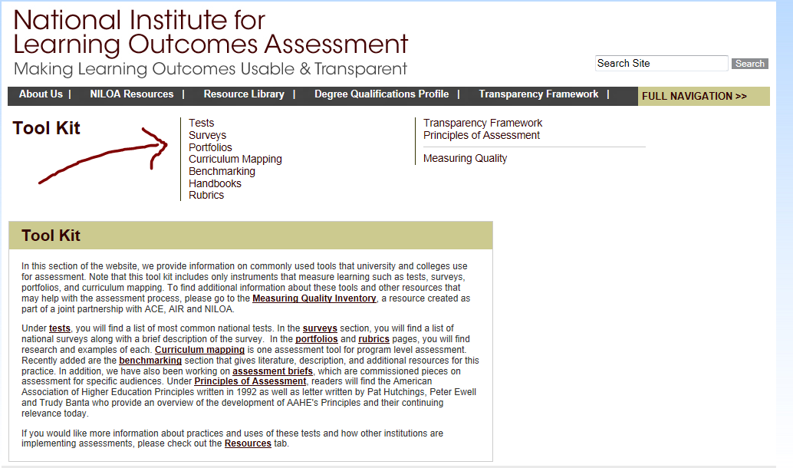
Implementing and Assessing 21st Century Skills

Slide 5
What is an EP?
The eportfolios of Mohawk graduates will be a curated collection of digital artefacts that demonstrate graduates’ abilities to communicate effectively, to collaborate productively, to think critically when solving challenging problems and to participate meaningfully in college, community, and global initiatives. Artefacts that will be included in each graduate’s eportfolio will include:
graded assessments from their program of study;
evaluations of their experiential learning opportunities;
and, record of their time and contributions to college, community, and global organizations.

Slide 6
What is an EP?
For an eportfolio implementation to be successful, the complete range of student growth must be presented, from academic achievements, to experiential learning, to extracurricular involvement so that the end result is a full showcase of that students’ learning, achievement, and experience while at Mohawk. More than this, the eportfolio presents a process whereby a student can reflect on their experiences and learn from them, within a quality pedagogical framework that has been thoughtfully constructed by teaching and learning professionals; Mohawk students will reflect on each eportfolio artefact defining how the artefact illustrates how they have become more skilled as communicators, collaborators, critical thinkers, lifelong learners, and responsible citizens. The end result is a digital record of a graduate’s professional and personal progress that can be shared with potential employers.

Slide 7
Goals of Working Group
Champion EPs at Mohawk
Learn about EPs to assist others with implementation
Assist with evaluation and selection of EP tool(s) at Mohawk
Provide advice, feedback re: implementation of EPs at Mohawk

Slide 8
Project Charter
Project Goals:
Phase 1 Identification of eportfolio products appropriate for assessment and demonstration of 21st Century skills.
Phase 2 Implementation of eportfolios in a cross-section of college programs.

Slide 9
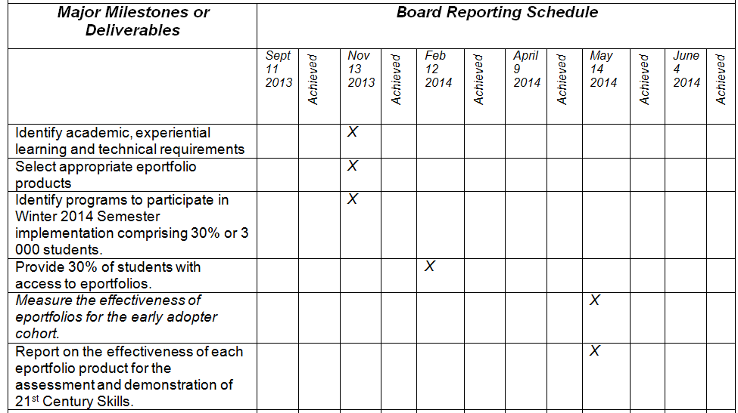
Project Charter

Slide 10
Project deliverables/outputs
Selection of tool – October/November
Education/Training – October (IM) and January
Implementation – 30% of students - January
Support – Winter semester
Championing - Ongoing
Assessment - March
Final report/recommendation - April

Slide 11
Timeline for Adoption & Use for 30% of Students in Winter 2014
September: Academic Plan Kickoff meetings
October: Rating/Ranking of 5 Eportfolio Products (based on RFP information) and Inspiring Minds: October 24th
November: Programs Choose Eportfolio Products; Licenses Purchased
December: Programs Determine Implementation Strategy (Graduating Semester) & Faculty Workshops
January: Implementation; Finalizing of Grading Rubrics
February-March: Feedback from Participants
April-May: Process Early Adopter Feedback

Slide 12
Roles and responsibilities on this project
Team role and responsibilities
Project managers (Valerie P, Jenn H)
Project sponsors/leads (Dan McKerrall, Ted Scott)
Technical lead (CTL – Jeffrey Rankine)
Pedagogy/Assessment lead (Peggy French)
Communications lead (Valerie Mitanoff)

Slide 13
Project documentation/info management
Project website
Agendas
Minutes
Resources

Slide 14
Communication plan for project
Presentations to Deans and ADs meetings
Presentations to faculty meetings
“Inspiring Minds” October 24th conference
VPA Update
Other? To be discussed at future meeting

Slide 15
Risks Identified
Risk | Likelihood | Impact | Risk Response
Project does not reach target of 30% of students using eportfolios by March, 2014. | M | H | Communication from Cheryl to ADs asking for target number of faculty to be volunteered by end of October - the communication of this target to ADs is vital to the success of the project. Presentations (Valerie/Jenn) to Deans and Associate Deans about the project. Communications (VP Report) on importance of project. Inspiring Minds – important that ADs and Deans see this as an opportunity for their faculty to choose their eportfolio tool for the Winter semester.

Slide 16
Risks Identified
Risk | Likelihood | Impact | Risk Response
Lack of faculty buy-in. | H | H | Valerie and Jenn to outline the amount of time required per faculty for a successful and quality eportfolio implementation and provide this information to the ADs. ADs add time to SWFs for faculty to successfully implement eporfolios in their courses during the Winter 2014 semester. It is imperative that ADs, in consultation with their Program Coordinators, identify a product and a course in which the eportfolio will be designated in time for SWFs to be developed (end of October/early Nov.)

Slide 17
Risks Identified
Risk | Likelihood | Impact | Risk Response
Lack of staff resources in CTL to support the 30% target for Winter 2014. (CTL is in the midst of an organizational change and are also dedicated to assisting faculty to reach the Dec. 2013 blended learning target.) | H | H | CTL staff to prioritize workload and, in consultation with management, choose ‘what not to do.’

Slide 18
Risks Identified
Risk | Likelihood | Impact | Risk Response
Union resistance | M | M | Project managers will meet with Union to review project and provide information.
Project cannot become operationalized beyond project end date. (Faculty will want to know if they can continue to use the tool in their curriculum for semesters that follow Winter 2014 -specifically if they are using the eportfolio with first year students.) | H | H | Funds will need to be allocated by college admin (for 12 – 24 months) so that any licensed eportfolio products that have been shortlisted during the project can be used beyond the target end date of the project. This is required in order to support the projected graduation date of students.

Slide 19
Risks Identified
Risk | Likelihood | Impact | Risk Response
Lack of dedicated budget for project | M | H | Ensure that there is sufficient funding during Sept. – Dec. timeframe to deploy the eportfolio products for the Winter 2014 deployment.
Lack of time to fully evaluate products and select best product for Mohawk due to short timeline. | L | H | An accelerated RFP process will be initiated in order to gather requirements and ensure products selected meet Mohawk’s requirements.

Slide 20
Q & A

Slide 21
Eportfolios@Mohawk College 30% of Students Using Eportfolios during Winter 2014 Questions, Comments, Thoughts, Concerns Jenn.Horwath@mohawkcollege.ca Valerie.Parke@mohawkcollege.ca

Slide 22
For next week…
http://eportfolio.lagcc.cuny.edu/support/faqs.htm
Other institutions that have implemented eportfolios

