Slide 1
Technology Pathways Learning 21st Century Skills Connections

Slide 2
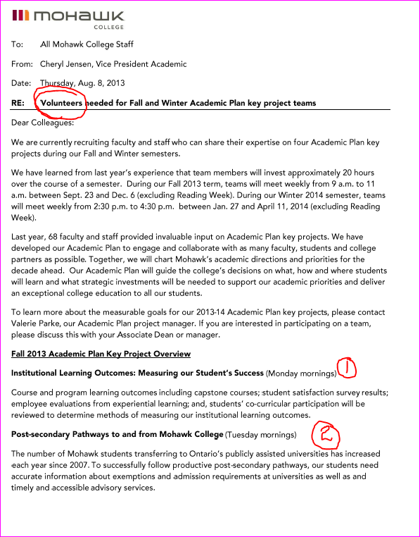
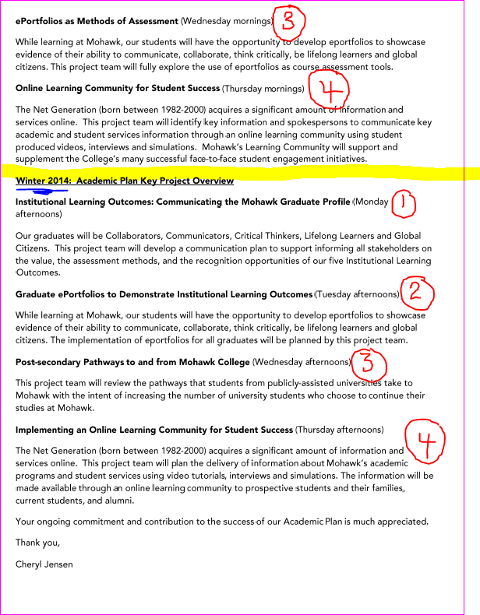

Slide 3
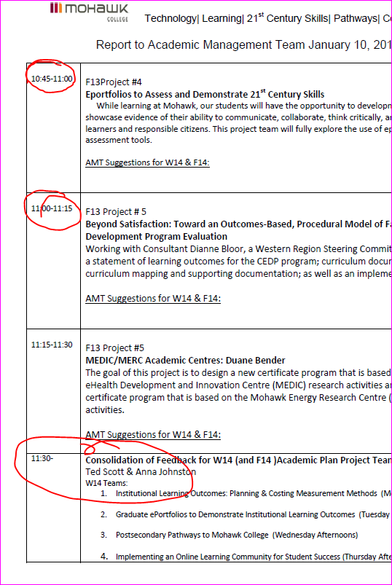
Project Task
The Team
Our Findings
Reflect on Suggestions for W14 & F14
In-camera Session
Numeracy Fluencies
Digital Fluencies
Alignment of Academic and Student Services Initiatives

Slide 4
F13 Academic Plan Project Teams
Institutional Learning Outcomes: Measuring Student Success
Pathways: Postsecondary Pathways from Mohawk to University
An Online Learning Community to Support Student Success
Eportfolios to Assess and Demonstrate 21st Century Skills
Beyond Satisfaction: Toward an Outcomes-Based, Procedural Model of Faculty Development Program Evaluation (CEDP)
MEDIC/MERC Academic Centres

Slide 6
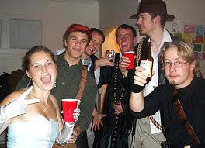
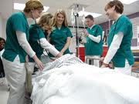
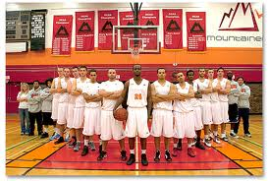
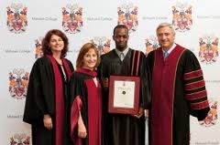
It takes an entire college to educate a student.

Slide 7
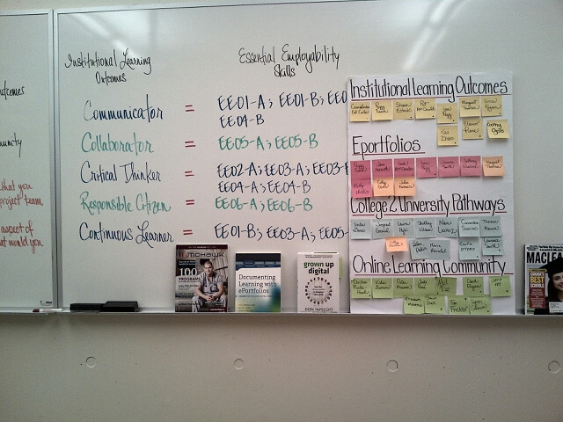
Rm. i-208, M-Th, 9-11, Design Thinking

Slide 8
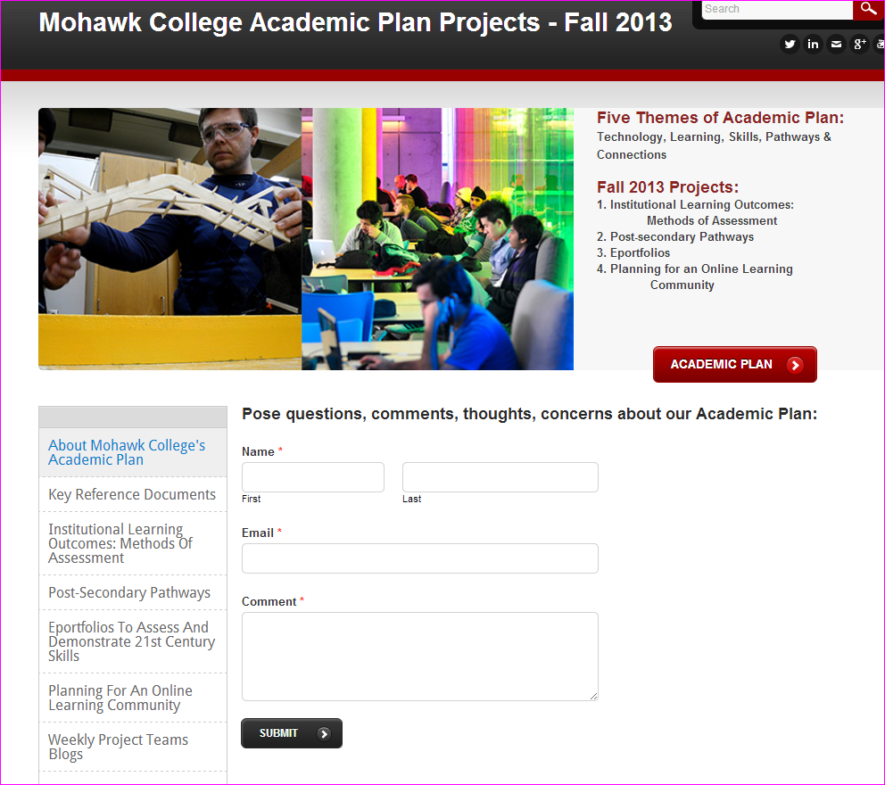

Slide 9
Project Team #1 Institutional Learning Outcomes: Measuring Student Success
The Task
The Team
Course and program learning outcomes including capstone courses; student satisfaction survey results; employee evaluations from experiential learning; and, students’ co-curricular participation will be reviewed to determine methods of measuring our institutional learning outcomes.
Carmelinda Del Conte
Sharon Estok
Erica Fagan
Peggy French
Pat MacDonald
Cathy Ozols
Lisa Pegg
Eleanor Pierre (Resource)
Margaret Thomson
Cynthia Williamson
Kai Zhao

Slide 10
Five Institutional Learning Outcomes Approved by Board of Governors April 2013
Mohawk College Graduates upon completion of one, two, or three year programs will be able to demonstrate their skills as:
Communicators
Collaborators
Critical Thinkers
Continuous Learners
Responsible Citizens

Slide 11
11 Essential Employability Skills Map to our 5 Institutional Learning Outcomes

Slide 12
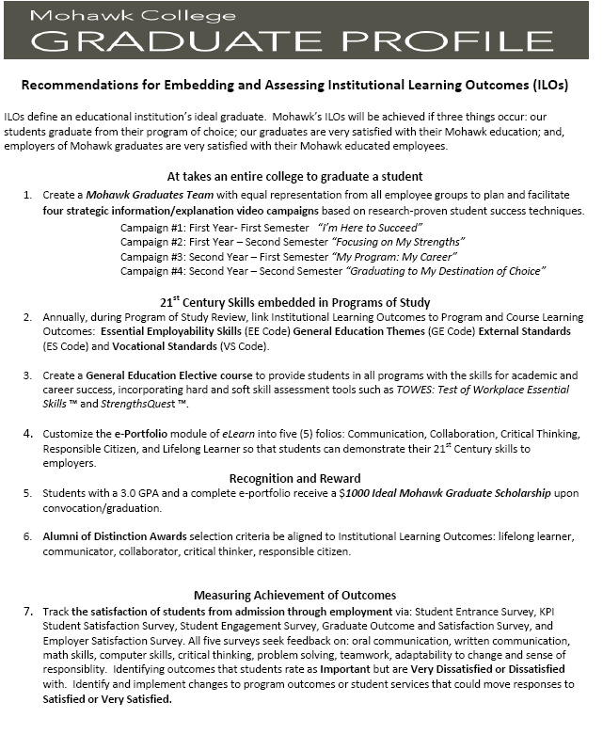

Slide 13
US: National Institute for Learning Outcomes Assessment CDN: Measuring the Value of a Postsecondary Education

Slide 14
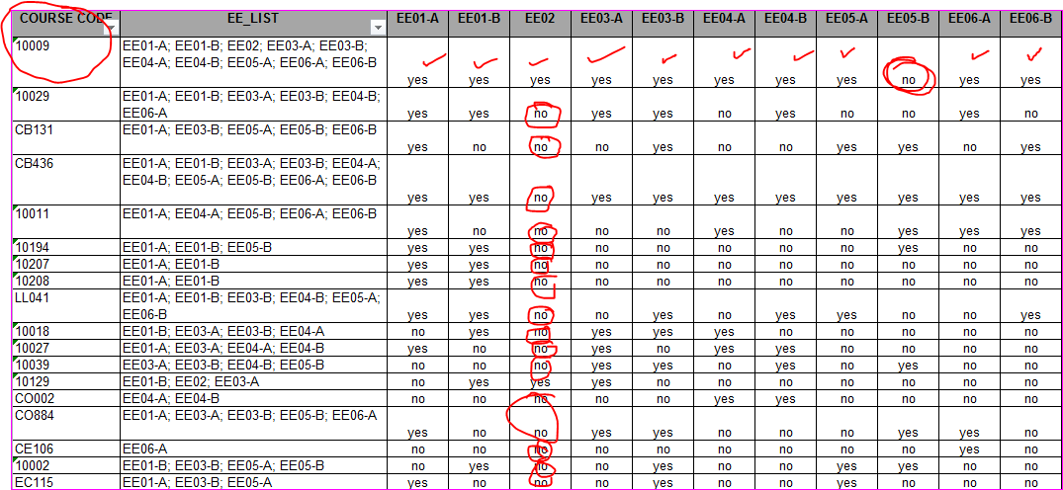
EE02 “Execute Math Operations” Accurately

Slide 15
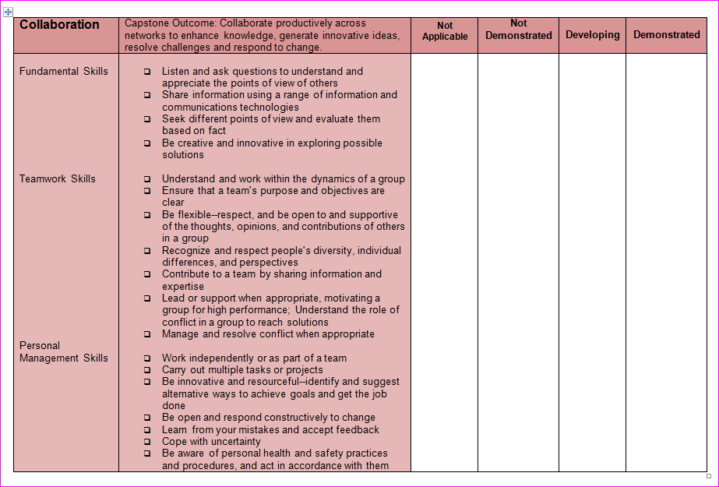
Collaborate productively across networks to enhance knowledge, generate innovative ideas, resolve challenges and respond to change.

Slide 16
ORBIS Workplace Integrated Learning Co-curricular Records

Slide 17
Select the Experience Statements that best describe what you have learned from your experience in this activity.

Slide 18
KPI Student Satisfaction Graduate Outcomes Satisfaction Survey Employer Satisfaction Survey
Oral Communication
Written Communication
Math Skills
Computer Skills
Critical Thinking
Problem Solving
Teamwork
Organization
Planning
Adaptive
Responsible
Very Dissatisfied
Dissatisfied
Not Satisfied
Satisfied
Very Satisfied
NA

Slide 19
It takes an entire college to graduate a student.

Slide 20
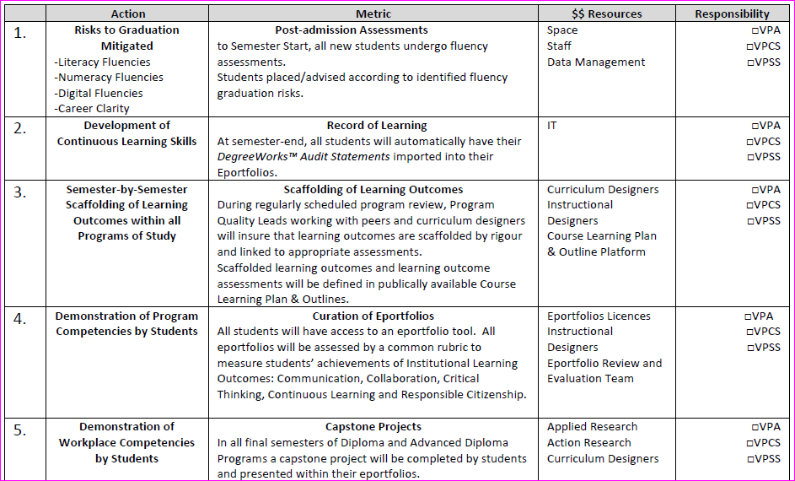

Slide 21
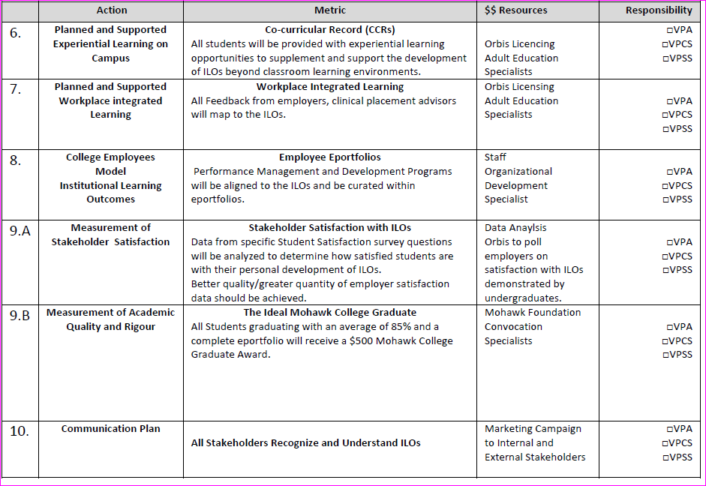

Slide 22
Fall 2013 Project #2 Postsecondary Pathways from Mohawk to University
The Task
The Team
The number of Mohawk students transferring to Ontario’s publically assisted universities has increased each year since 2007. To successfully follow productive post-secondary pathways, our students need accurate information about exemptions and admission requirements to universities as well as and timely and accessible advisory services.
Linda Basso
Maria Berrafati
Jaspreet Grewal
Shelley Kitchen
Nair LaCruz
Theresa Merwin
Celia Otero
Cathy Ozols
Casandra Saiciuc
Laurence Smith

Slide 23
College to University Pathways

Slide 24
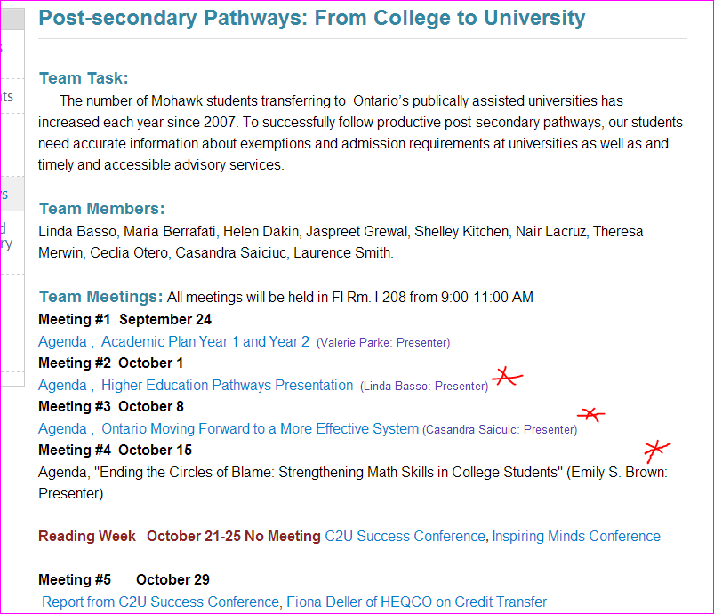

Slide 25
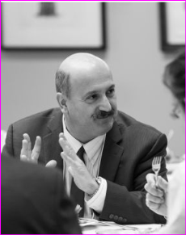
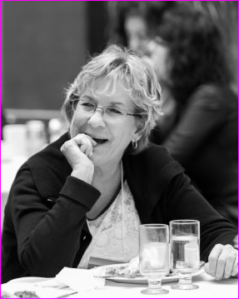
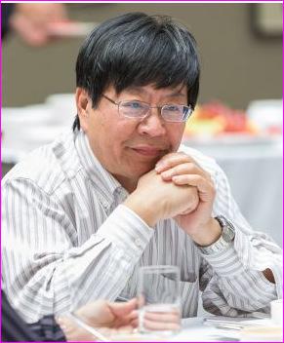
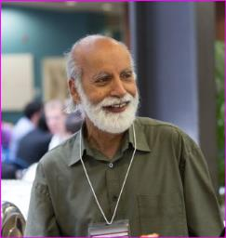

Slide 27
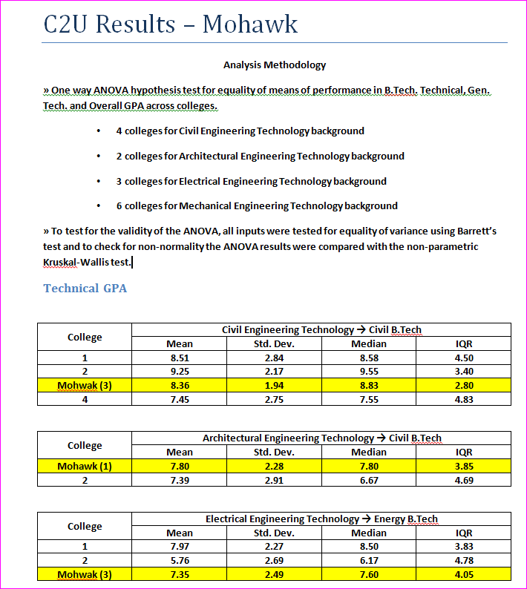

Slide 29
EE02 “Execute Math Operations” Accurately

Slide 30
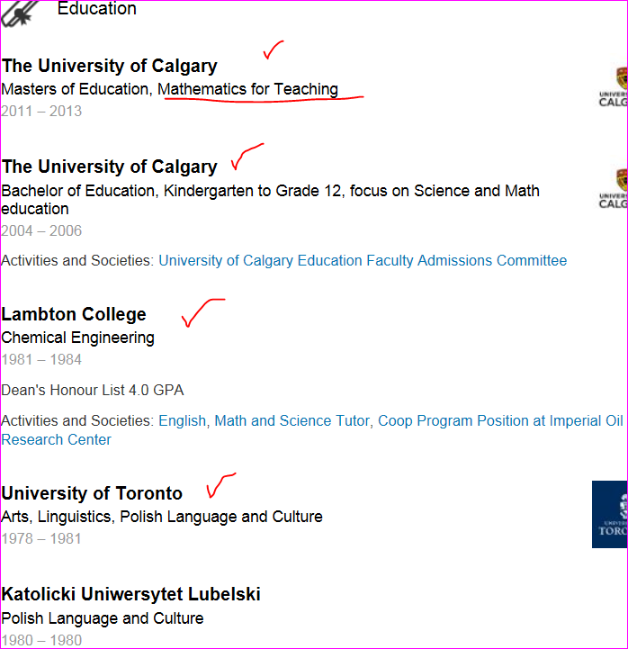
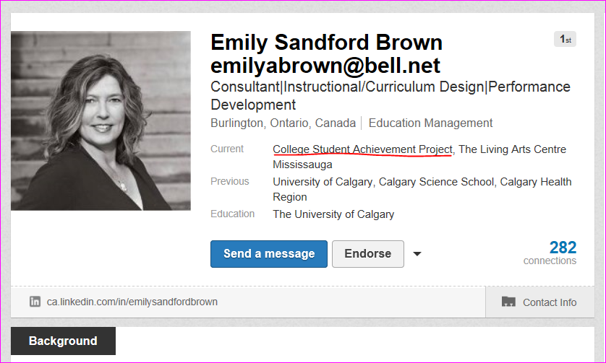

Slide 31
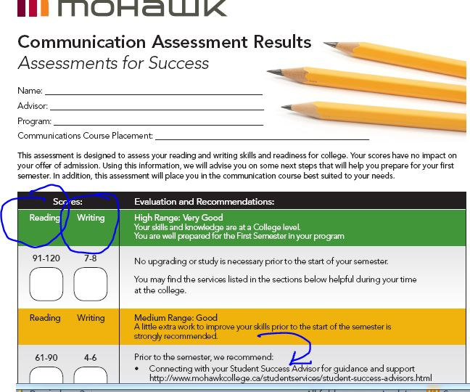
Student Entrance Survey
Fractions
Decimals
Percentages

Slide 34
Mohawk’s Five CTIG Projects
Project #1: Data Collection and Reporting Capacity of Current Exemption Database - CTIG Funding $68 000
Project #2: Transfer Facilitation Activities & Student Future Ready Coach Program - CTIG Funding $34 000
Project #3: Mohawk College Pathways Office - CTIG Funding: $70 000
Project #4: Annual Pathways Fair - CTIG Funding: $15 000
Project #5: General Arts and Science 2+2 Provincial Reference Pilot - CTIG Funding $15 000

Slide 36
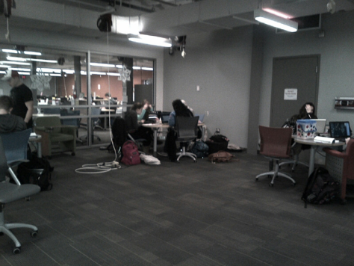

Slide 39
College2University Kiosk Project January 2-March 31, 2014
Project Manager
FutureadyCoach
Communications
2 Days
FutureadyCoach
Academic Quality
5 (Schools) x 5 hours
FutureadyCoach
Data Collection
2 Days
FutureadyCoach
Advising
3 Days

Slide 40
Fall 2013 Project #3 Eportfolios to Assess and Demonstrate 21st Century Skills
The Task
The Team
While learning at Mohawk, our students will have the opportunity to development eportfolios to showcase evidence of their ability to communicate, collaborate, think critically, and be continuous learners and responsible citizens. This project team will fully explore the use of eportfolios as course assessment tools.
Julie Aumais
Peggy French
Kathy Hicks
James Humphreys
Leah MacCharles
Lex (Alexia) Neziol
Cathy Ozols
Dawn Pielechaty
Lisa Pegg
Jeffrey Rankine
Joanne Smith
Jenn Horwath Co-Project Manager
24 Eportfolio Leads
32 Early Adopters

Slide 41
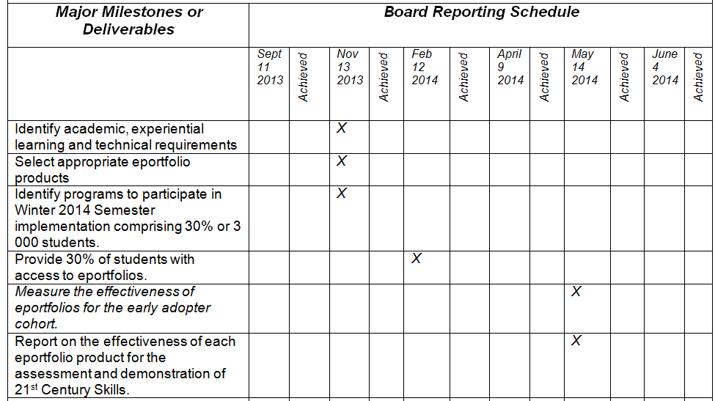
Eportfolio Project Charter

Slide 42
Timeline for Adoption & Use for 3 000 Students in Winter 2014
September: Rating/Ranking of 5 Eportfolio Products
October: Inspiring Minds: Oct. 24th
November: ADs , with their program faculty, define eportfolio software, course(s), student numbers.
December: 3 000 Licenses acquired
January: Faculty Training January 2,3 Finalizing of Grading Rubrics January 6
February-March: Faculty Community of Practice; Polling of Participants (1-2 hours per week)
April-May: Process Early Adopter Feedback

Slide 43
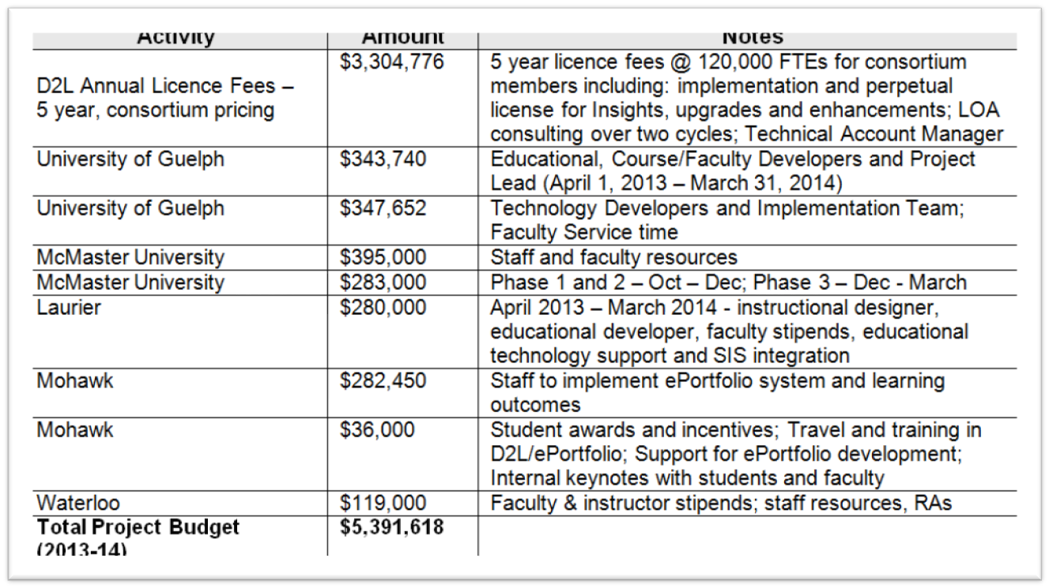
PIF Project

Slide 44
PIF Project until March 31, 2014
The Support Team
Eportfolio Leads “Connectors”
to Early Adopters
SSAs & Graduate Employment
Jeffery Rankine
Kathleen Kennedy
Peggy French
Eva Standish
Jenn Horwath

Slide 45
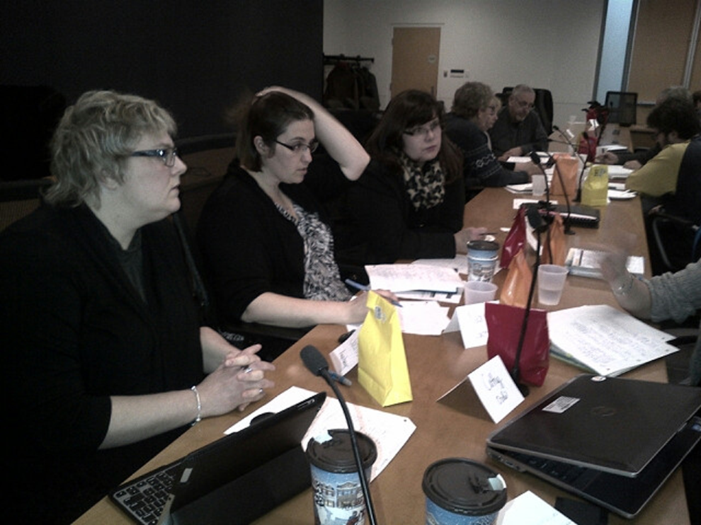
Eportfolio Training January 2,3,6

Slide 46
eP/ ILO Course

Slide 49
PIF Project

Slide 50
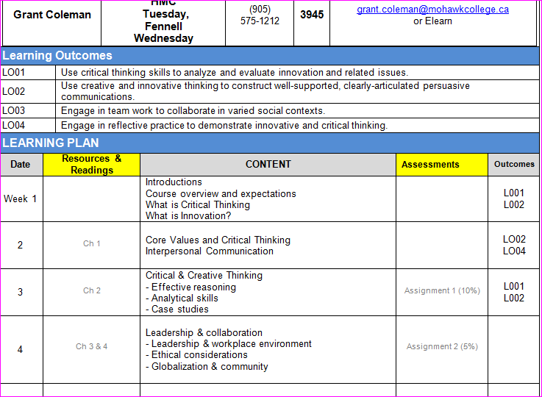

Slide 51
Fall 2013 Project #4 An Online Learning Community to Support Student Success
The Task
The Team
The Net Generation (born between 1982-2000) acquires a significant amount of information and number of services online. This project team will identifying key information and spokespersons to communicate key academic and student services information through via an online learning community using student produced videos, interviews and simulations. Mohawk’s Learning Community will support and supplement Mohawk’s many successful face-to-face student engagement initiatives.
Christine Boyko-Head
Katie Burrows
Lynn Coleman
Peggy French
Tim Fricker
Larisa Fry
Darryl Hartwick
Shaun Illes
Elizabeth Martin
Peter Maurin
Cathy Ozols
Judi Paré
David Ragona
Atul Rao

Slide 52
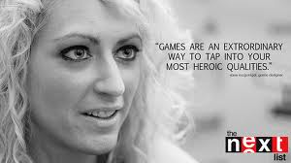
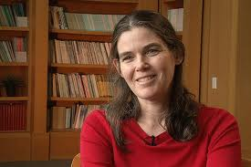
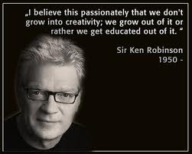
Thought Leaders Don Tapscott, Daphne Koller, Jane McGonigal, Sherry Turkle, Sir Ken Robinson

Slide 54
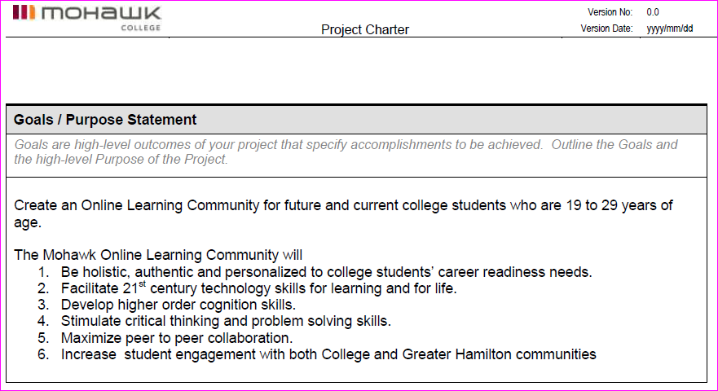
Draft OLC Small Project Chart

Slide 55
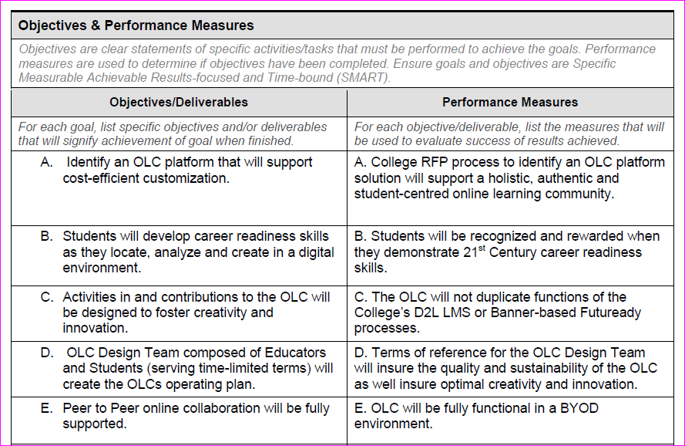
Draft OLC Small Project Chart

Slide 56
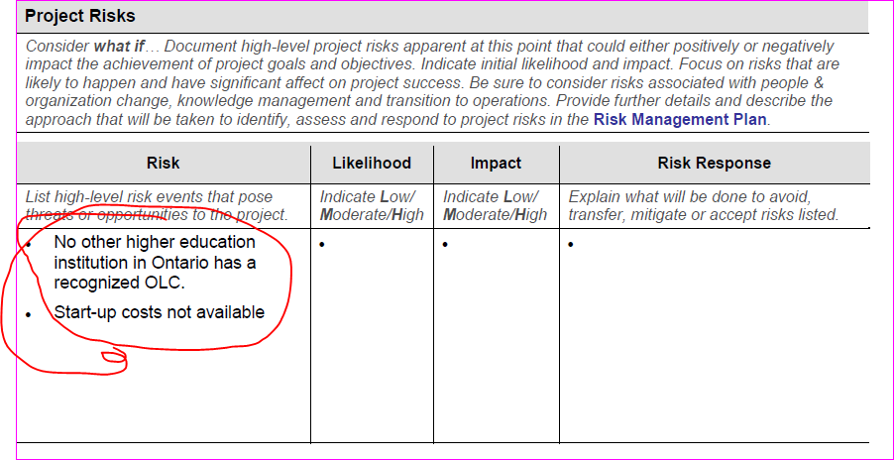
Draft OLC Small Project Chart

Slide 57
Fall 2013 Project #5 Renewal of College Educator Development Program: PIF Project
The Task
The Steering Committee
Working with Consultant Dianne Bloor, December ‘13-March ‘14, a Western Region Steering Committee will develop a statement of learning outcomes for the CEDP program; curriculum documents including curriculum mapping and support documentation; as well as an implementation plan.
Conestoga College
Fanshawe College
Lambton College
Mohawk College
Niagara College
St. Clair College

Slide 58
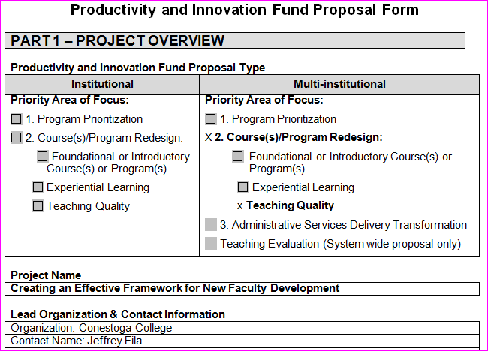
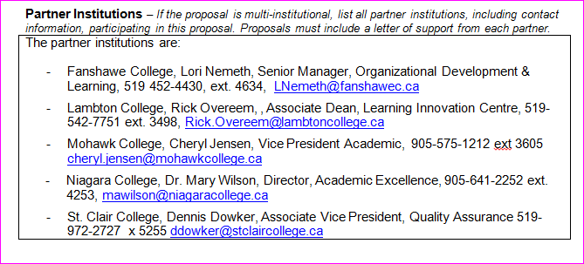
CEDP Renewal

Slide 59
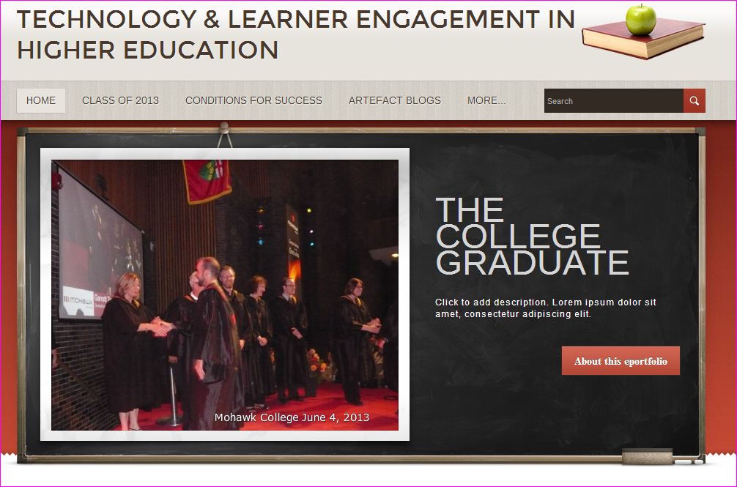

Slide 60
Fall 2013 Project #6 MEDIC/MREC Planning
The Task
The Team
The goal of this project is to design a new certificate program that is based on the mobile-eHealth Development and Innovation Centre (MEDIC) research activities and a new certificate program that is based on the Mohawk Energy Research Centre (MERC) research activities.
Duane Bender
Justine Fyfe
Arun Agarwal
Internationally recognized industry experts

Slide 61
F13 Academic Plan Project Teams
Institutional Learning Outcomes: Measuring Student Success
Pathways: Postsecondary Pathways from Mohawk to University
An Online Learning Community to Support Student Success
Eportfolios to Assess and Demonstrate 21st Century Skills
Beyond Satisfaction: Toward an Outcomes-Based, Procedural Model of Faculty Development Program Evaluation (CEDP)
MEDIC/MERC Academic Centres

