Slide 1
D2L ePortfolios@Mohawk
Workshop Agenda
Introductions
Institutional Learning Outcomes
Eportfolios for Learning and Employment
Hands-on D2L ePortfolio Training: Part I
Lunch with Colleagues
Hands-on D2L ePortfolio Training: Part II
Tasks of Eportfolio Team Members Winter 2014
Feedback Survey – Online Post-workshop

Slide 2
Eportfolio Personnel
Early Adopters
Desire2Learn ePortfolio Trainer
CTL Support Team including Library TechBar Staff
Student Services Staff including SSAs & Graduate Employment
Eportfolio Project Team (January 27-April 17)
Eportfolio Leads including Faculty, Technologists, Co-op Specialists

Slide 3
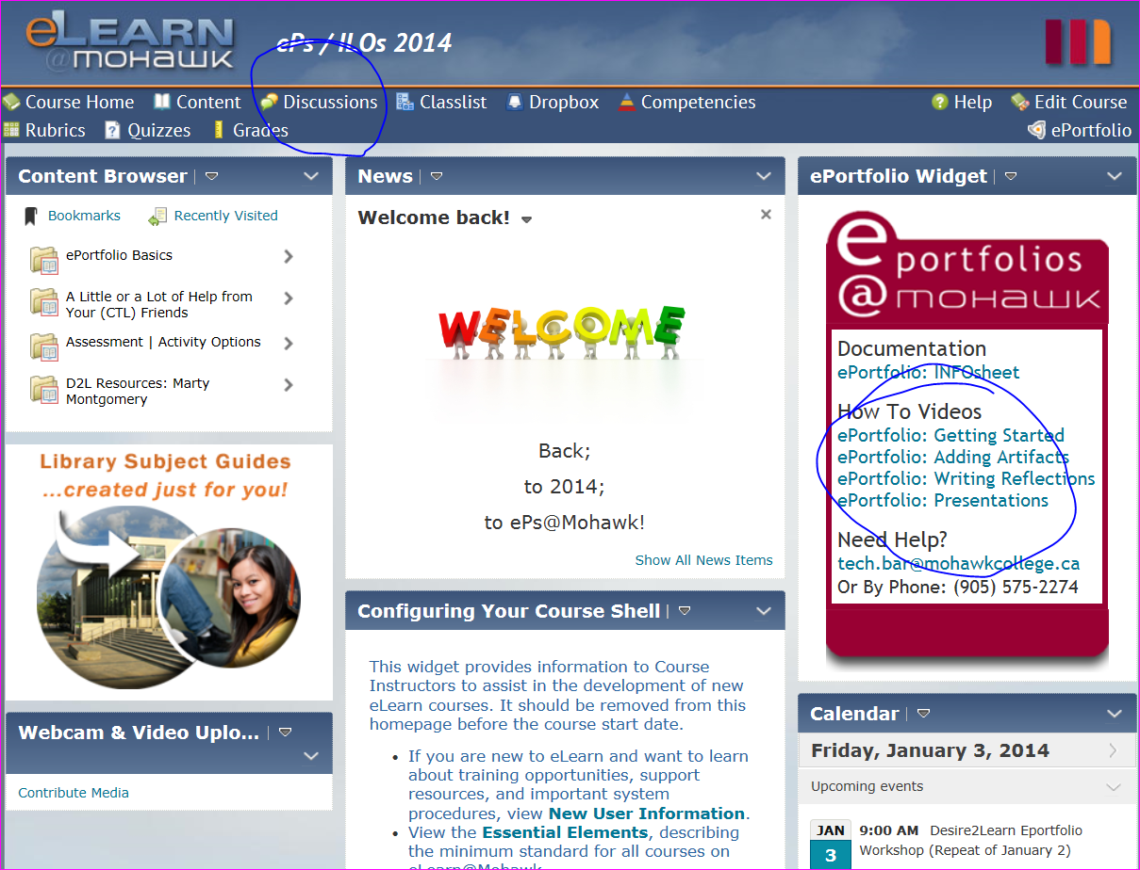

Slide 5
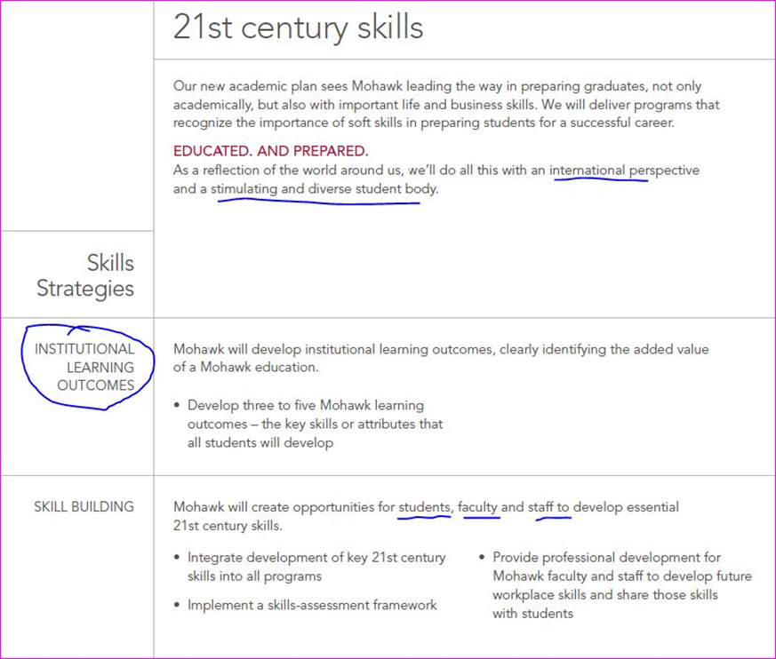

Slide 6
Institutional Learning Outcomes Team Fall 2012-Winter 2013
Ann Bennett
Sandy Bozak
Karen Brown
Catherine Byron
Karen Lavell
Leah MacCharles
Dan McKerrall
Sue Nadwodny
Cathy Ozols
Lynn Paddon
Valerie Parke
Sharon Scollard
Amanda Tallon
Carol Trisanti
Douglas Wells

Slide 7
100+ Internal Stakeholders

Slide 8
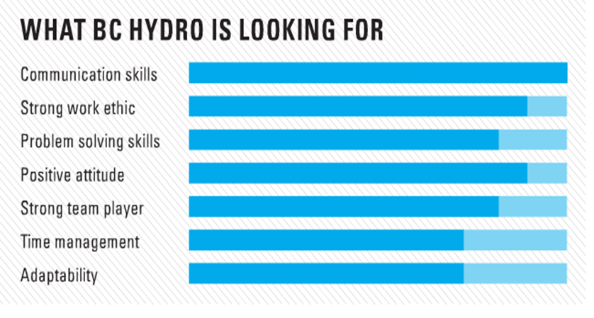
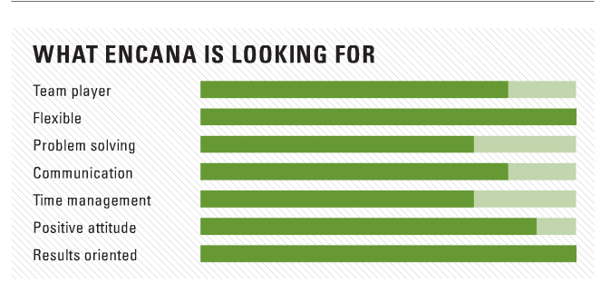
What External Stakeholders ( Top Employers) Want:

Slide 9
Communication Skills
Problem Solving Skills
Willingness to Learn/Fast Learning
Team Player, Team Spirit/Collaboration
Intrapersonal Skills/Respectful/Inclusion
Work Ethic/Determination/Integrity

Slide 10
Five Institutional Learning Outcomes
Communication
Collaboration
Critical Thinking
Continuous Learning
Responsible Citizenship

Slide 11
11 Essential Employability Skills Map to our 5 Institutional Learning Outcomes

Slide 12
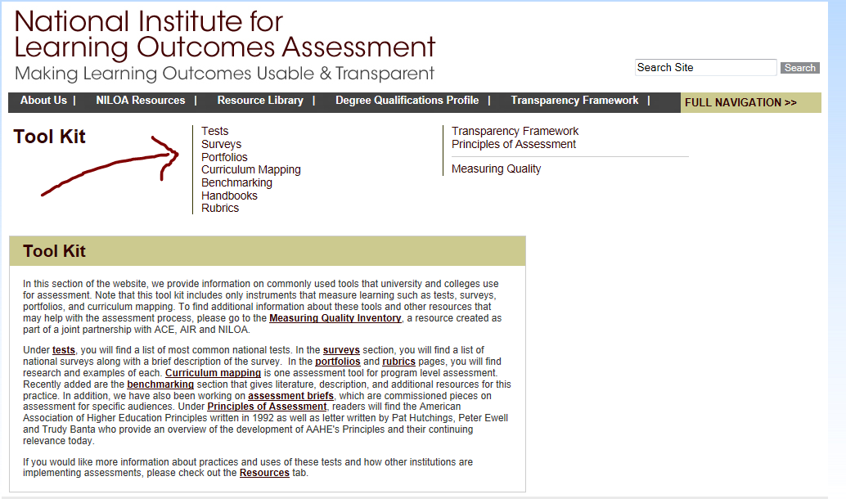
Implementing and Assessing 21st Century Skills

Slide 13
Five Institutional Learning Outcomes Approved by Board of Governors April 2013
Mohawk College Graduates upon completion of one, two, or three year programs will be able to demonstrate their skills as:
Communicators
Collaborators
Critical Thinkers
Continuous Learners
Responsible Citizens

Slide 14
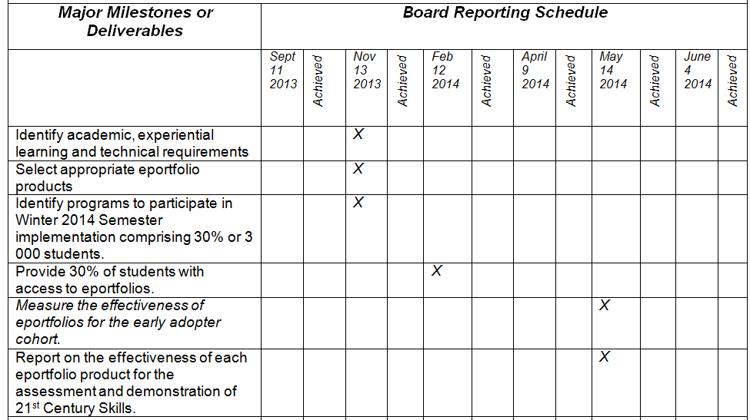
VPA Cheryl Jensen’s Eportfolio Project Charter

Slide 15
Eportfolio Project Team Fall 2013
Julie Aumais
Peggy French
Kathy Hicks
Jenn Horwath
James Humphreys
Leah MacCharles
Lex Neziol
Cathy Ozols
Valerie Parke
Dawn Pielechaty
Lisa Pegg
Jeffrey Rankine
Joanne Smith
Margaret Thomson

Slide 16
Eportfolios Evolving Since 2001
University of Denver
University of Washington
Virginia Tech
University of Texas at San Antonia
Western Governors University
Penn State University
LaGuardia Community College

Slide 17
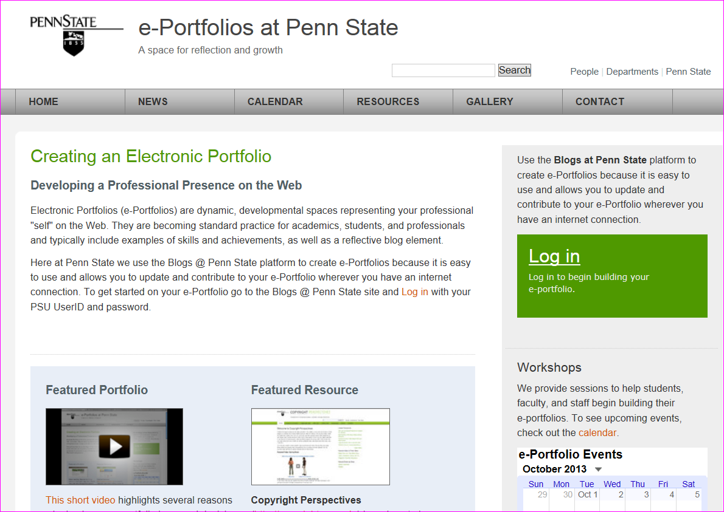

Slide 18
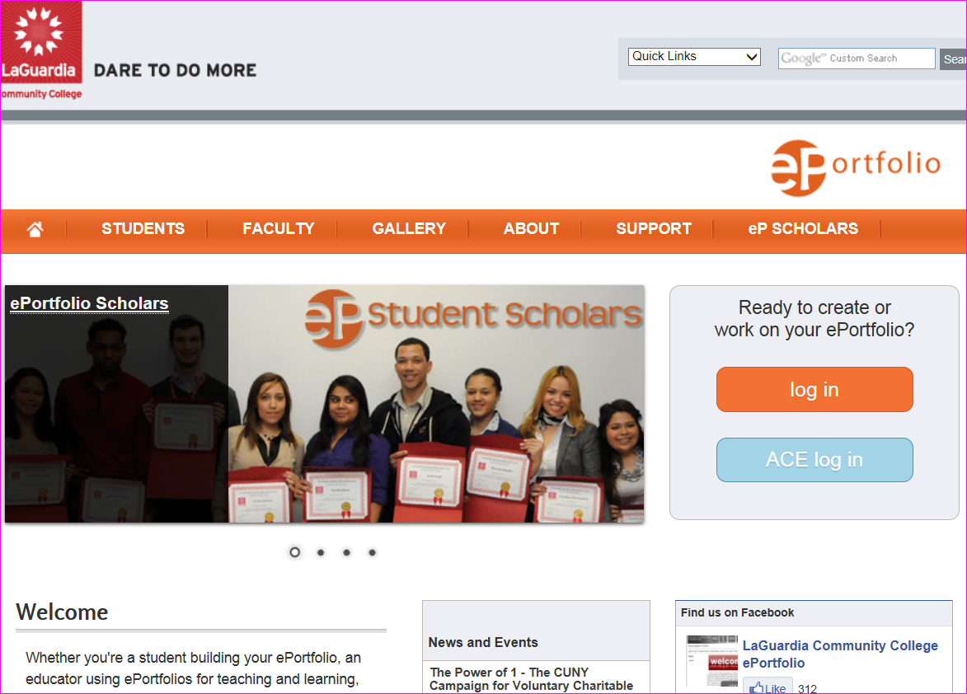

Slide 20
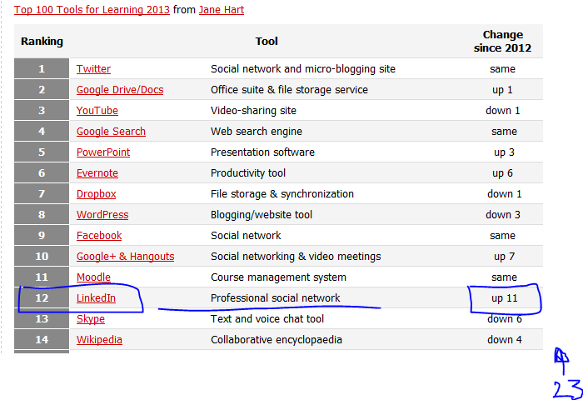

Slide 22
Documenting Learning with ePortfolios: A Guide of College Instructors 2012 Light, Chen & Ittelson
Seven Stage Implementation Framework
Defining learning outcomes
Understanding your learners
Identifying stakeholders
Designing learning activities
Using rubrics to evaluate ePortfolios
Anticipating external use of evidence
Evaluating the impact of eportfolios

Slide 23
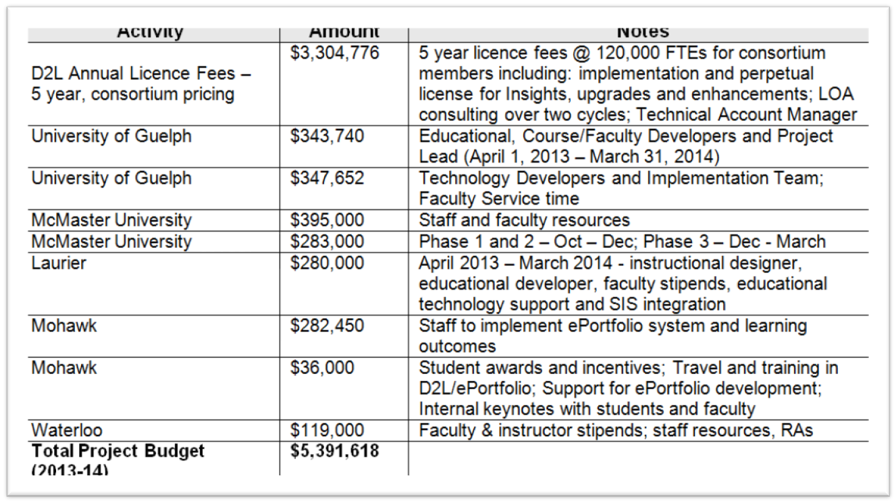
PIF Project

Slide 25
Sample Mohawk Graduate Eportfolio
Cheryl Jensen VPA

Slide 26
Eportfolios: Skills, Achievements, and Learning

Slide 27
Sample Mohawk Graduate Eportfolio
Cheryl Jensen VPA

Slide 28
Documenting Learning with ePortfolios: A Guide of College Instructors 2012 Light, Chen & Ittelson
Seven Stage Implementation Framework
Defining learning outcomes
Understanding your learners
Identifying stakeholders
Designing learning activities
Using rubrics to evaluate ePortfolios
Anticipating external use of evidence
Evaluating the impact of eportfolios

Slide 29
Eportfolio Leads
Christine Boyko-Head
Mark Cormier
Robert Deeks
Christine DiCarol
Lisa Dietrich
Karen Falls
Darryl Hartwick
John Holloway
Nair Lacruz
Janet Mannen
Sean Nix
Lisa Safian
Pat Schwenk
Don Shaw
Ajesh Singh
Joanne Smith
Roman Szpurko
Carol Tristani
Diane Van Meeteran

Slide 30
Online Survey
A nine question survey will be emailed to you after this workshop.
http://www.surveymonkey.com/s.aspx?PREVIEW_MODE=DO_NOT_USE_THIS_LINK_FOR_COLLECTION&sm=GRAxiS3b3S22xMtehr%2fIsQvY8TROZzqlWSfjjc8jtgA%3d

