Slide 1
eportfolios@Mohawk & PIF Learning Outcome Assessment Project
Planning Workshop for Eportfolio Leads
School Teams for Breakfast & Introductions
2014 Winter Semester PIF Project + eportfolios@mohawk
D2L Post-workshop Survey Results
Remarks from VPA Cheryl Jensen
The Role of Eportfolio Leads
Reflecting of Learning
Feedback on eportfolios@mohawk
The Evolution of Eportfolios : James Humphreys

Slide 2
Eportfolio Leads
Introduce yourself to the Eportfolio Leads within your school.
Share the name of the course you enjoy teaching most.
Share why it is your most favourite course.

Slide 3
Five Institutional Learning Outcomes Approved by Board of Governors April 2013
Mohawk College Graduates upon completion of one, two, or three year programs will be able to demonstrate their skills as:
Communicators
Collaborators
Critical Thinkers
Continuous Learners
Responsible Citizens

Slide 4
11 Essential Employability Skills Map to our 5 Institutional Learning Outcomes

Slide 5
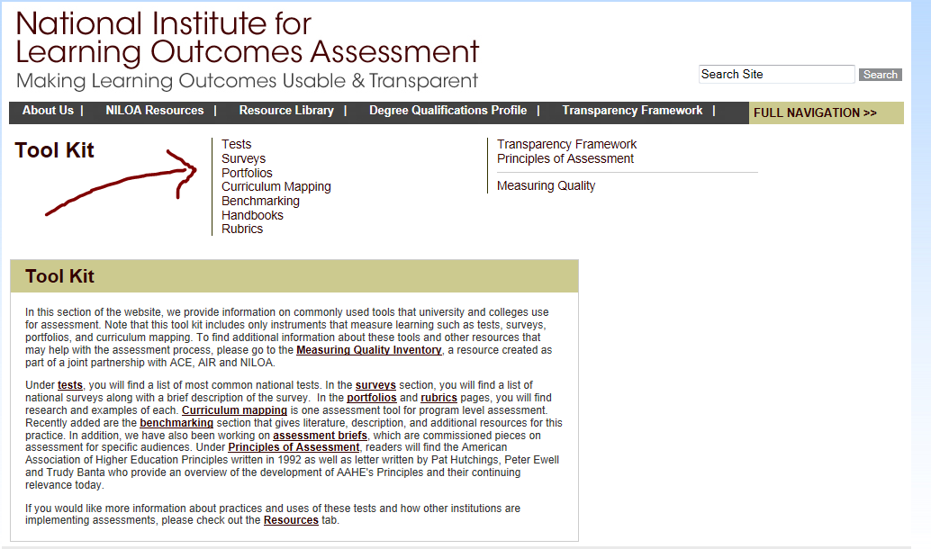
Implementing and Assessing 21st Century Skills

Slide 6
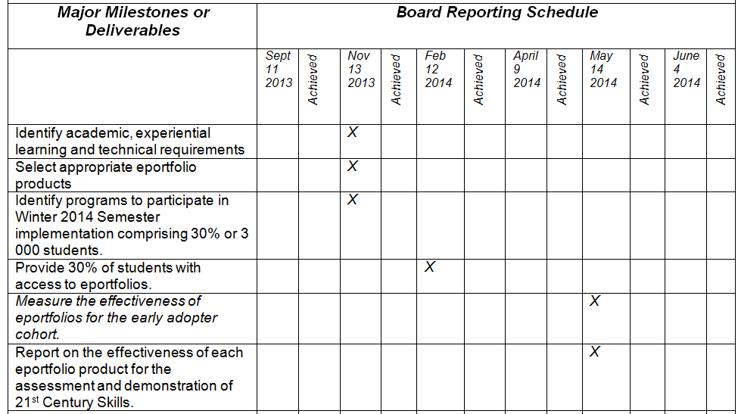
VPA Cheryl Jensen’s Eportfolio Project Charter

Slide 7
Documenting Learning with ePortfolios: A Guide of College Instructors 2012 Light, Chen & Ittelson
Seven Stage Implementation Framework
Defining learning outcomes
Understanding your learners
Identifying stakeholders
Designing learning activities
Using rubrics to evaluate eportfolios
Anticipating external use of evidence
Evaluating the impact of eportfolios

Slide 8
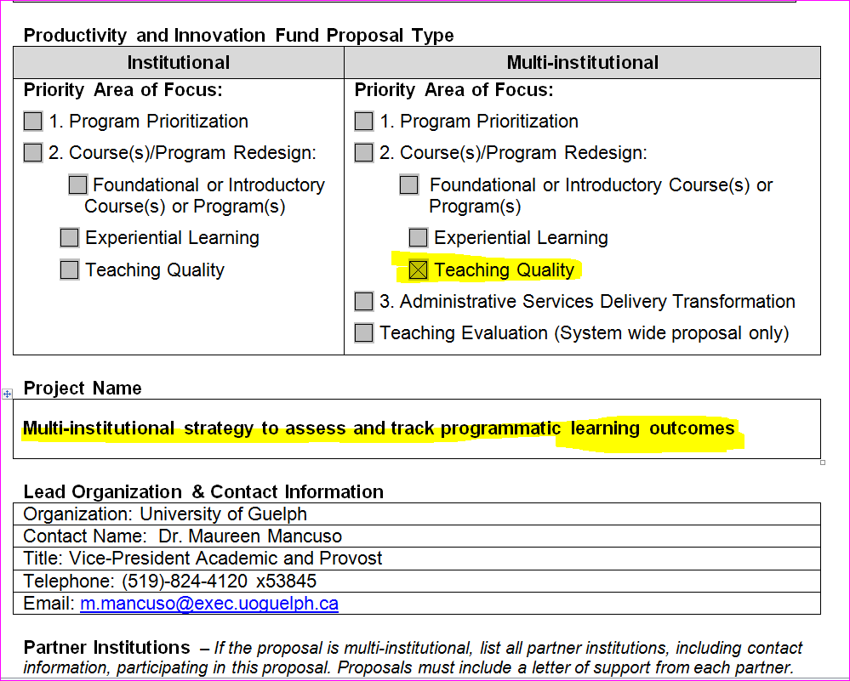

Slide 9
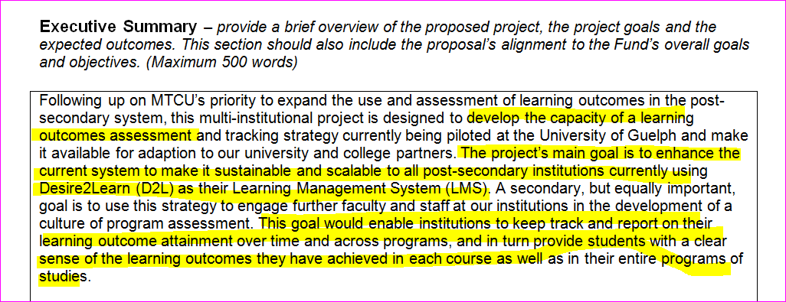
Institutional Learning Outcomes = Essential Employability Skills

Slide 10
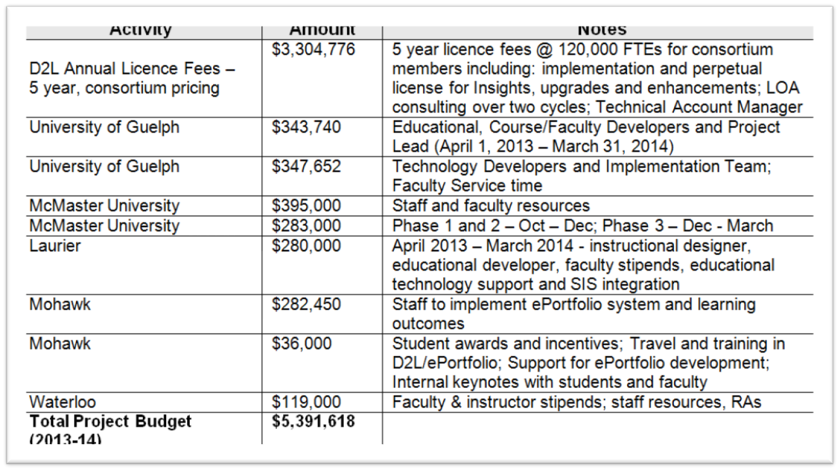
PIF Project

Slide 11
Eportfolio Personnel
Eportfolio Leads including Faculty, Technologists, Co-op Specialists
Desire2Learn ePortfolio Trainer
CTL Support Team including Library TechBar Staff
Student Services Staff including SSAs & Graduate Employment

Slide 12
Eportfolio Leads
Christine Boyko-Head
Mark Cormier
Robert Deeks
Christine DiCarol
Lisa Dietrich
Karen Falls
Daryl Hartwick
John Holloway
Nair Lacruz
Janet Mannen
Sean Nix
Lisa Safian
Pat Schwenk
Don Shaw
Ajesh Singh
Joanne Smith
Roman Szpurko
Carol Tristani
Diane Van Meeteran

Slide 13
11 Essential Employability Skills Map to our 5 Institutional Learning Outcomes

Slide 14
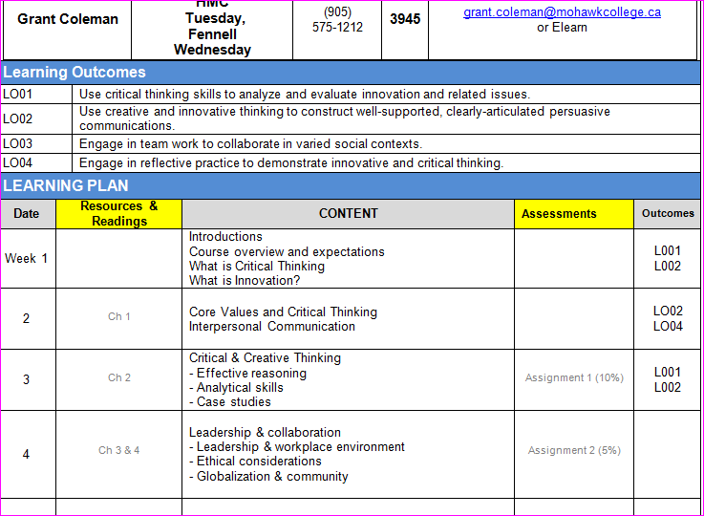

Slide 15
Documenting Learning with ePortfolios: A Guide of College Instructors 2012 Light, Chen & Ittelson
Seven Stage Implementation Framework
Defining learning outcomes
Understanding your learners
Identifying stakeholders
Designing learning activities
Using rubrics to evaluate ePortfolios
Anticipating external use of evidence
Evaluating the impact of eportfolios

Slide 16
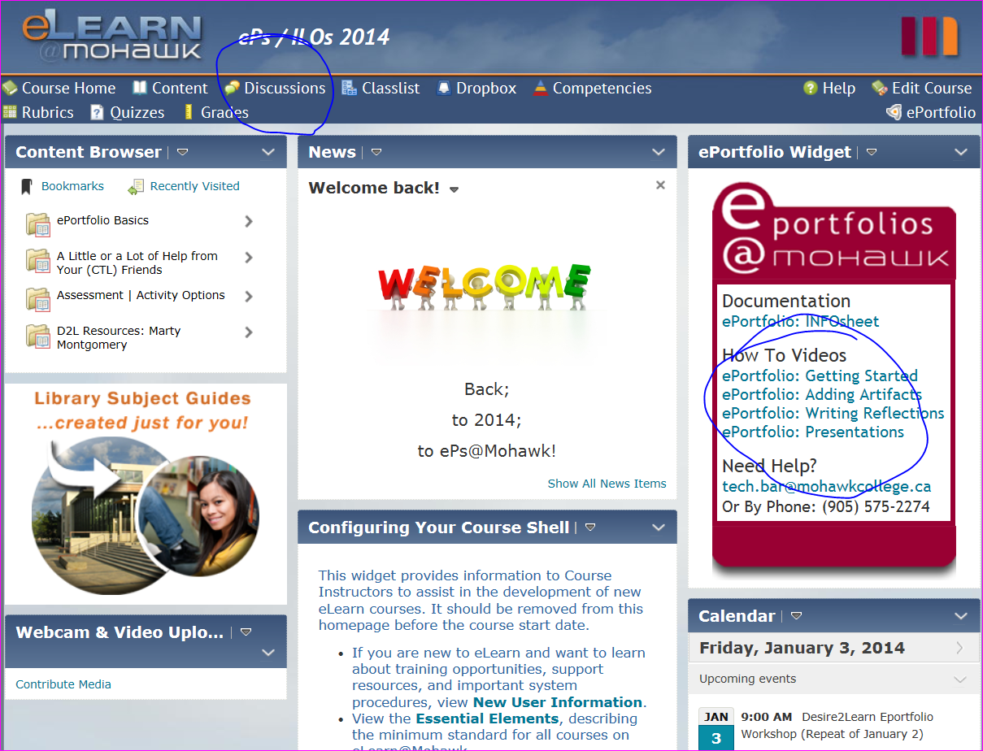

Slide 17
11 Essential Employability Skills Map to our 5 Institutional Learning Outcomes

Slide 18
Five Institutional Learning Outcomes Approved by Board of Governors April 2013
Mohawk College Graduates upon completion of one, two, or three year programs will be able to demonstrate their skills as:
Communicators
Collaborators
Critical Thinkers
Continuous Learners
Responsible Citizens

Slide 19
Survey of Stakeholders
Students – Participating, Non-Participating, Alumni
Faculty – Participating, Non-Participating
Student Services
Co-op and Graduate Employment
Employers
PIF Project Members

